Slide 1
DESIGNING AND CONSTRUCTING ONLINE COURSES ON COURSERA

Slide 2
Learning Domains
eLearning
Face-to-face
Cognitive
Affective
Psychomotor
Interpersonal
Intellectual skills
Procedural Knowledge(Recall), Comprehension, Application, Analysis, Synthesis, Evaluation
Graphs, Presentations, Discussion forums, Graphics, Case studies, Drill and Practice, Animation, Simulations etc.
Attitude and Motivation
Willingness to listen, participate, get involved, become an advocate, change one’s behavior, lifestyle, or way of life.
Tips from practitioners, former students, explaining content
Motor + cognitive skills
movement, coordination, manipulation, dexterity, grace, strength, speed
Lab courses, Vocational courses, Physical education courses, training in using specified equipment such as computers, cameras, musical instruments , Performing arts
People skills
Listening, Negotiating, Disagreeing, Decision making, Supporting, Compromising
seeing models, practicing the skills, and getting feedback in the form of coaching
DELIVERY
Notes:
Most e-learning courses are developed to build cognitive skills; the cognitive domain is the most suitable for e-learning. Within the cognitive domain, thinking skills may require more interactive e-learning activities because those skills are learned better “by doing”. Learning in the interpersonal domain can also be addressed in e-learning by using specific methods. For example, interactive role playing with appropriate feedback can be used to change attitudes and behaviours.
Learning domains/categories of lear
ning outcomes
Lab courses for science classes
· Vocational courses
· Physical education courses
· Training in using specified equipment such as computers, cameras, musical instruments etc.
· Performing arts
Former students giving tips on how to be successful
· The instructor informing the students of the value of the course
· Professionals who are using the knowledge from the course in their lives
· An overview of the program with key support personnel and facilities visible to the student
· Streaming audio files throughout the course encouraging students and providing helpful tips
· Short video clips of the instructor explaining course content

Slide 3
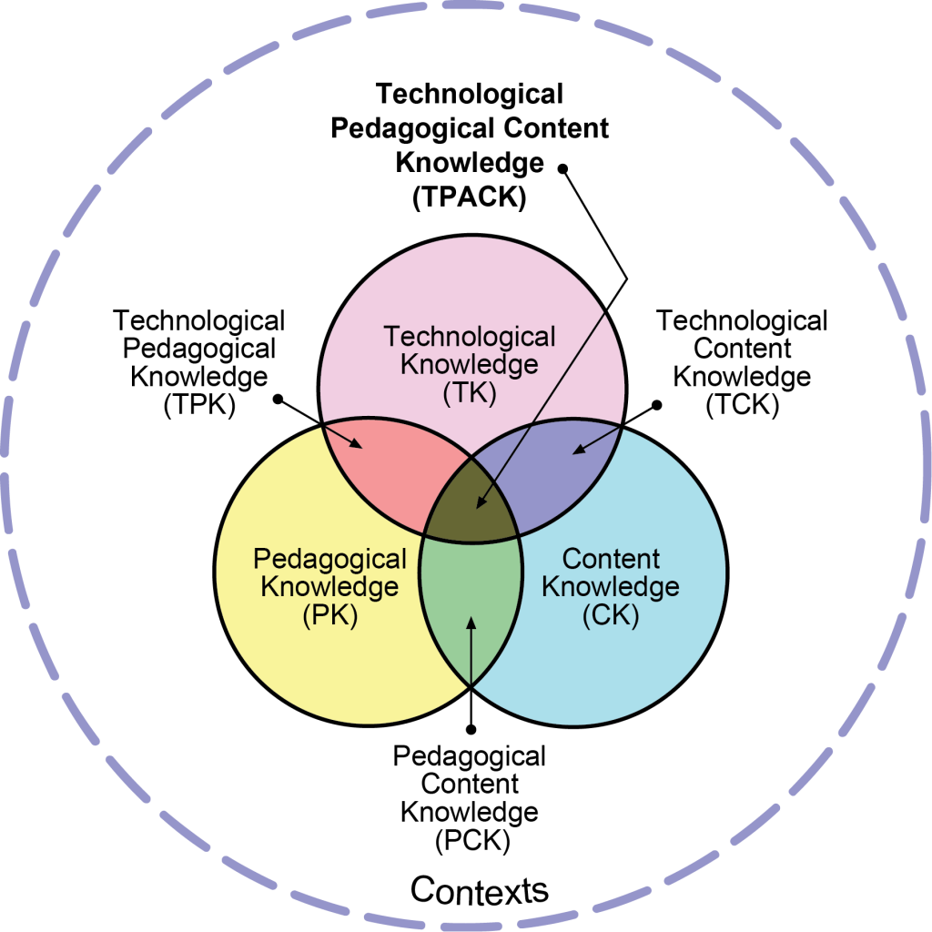
TPACK
reproduced by permission of the publisher, © 2012 by tpack.org
Notes:
Technological Pedagogical Content Knowledge (TPACK), attempts to capture some of the essential qualities of knowledge required by teachers for technology integration in their teaching, while addressing the complex, multifaceted and situated nature of teacher knowledge. At the heart of the TPACK framework, is the complex interplay of three primary forms of knowledge: Content (CK), Pedagogy (PK), and Technology (TK).

Slide 4
TPACK Explained
Content Knowledge (CK) – Knowledge about the subject matter to be learned or taught.
Pedagogical Knowledge (PK) – Knowledge about the processes and practices or methods of teaching and learning.
Technology Knowledge (TK) – Knowledge about certain ways of thinking about, and working with technology, tools and resources.
Pedagogical Content Knowledge (PCK) – Knowledge of pedagogy that is applicable to the teaching of specific content.
Technological Content Knowledge (TCK) – Knowledge of the manner in which technology and content influence and constrain one another.
Technological Pedagogical Knowledge (TPK) – Knowledge of how teaching and learning can change when particular technologies are used in particular ways.

Slide 5
When to use eLearning
Learning Domain: training aims to build cognitive skills rather than psychomotor skills;
Large Class sizes: Large amount of content to be delivered to a large number of learners;
Location: learners from geographically dispersed locations;
Time constraints: learners have limited mobility, limited daily time to devote to learning;
Technical skills: learners do not have effective listening and reading skills; learners have at least basic computer and Internet skills;
Learner Motivation: learners are highly motivated to learn and appreciate proceeding at their own pace; content must be reused for different learners’ groups in the future;
Analytics: there is a need to collect and track data.

Slide 6
COMPARE…
Instructional design
Focus on ‘instruction’, often as ‘transmission
Delivering content
Design centres on selection and sequencing of content
Designs may be broad, systemic, e.g. whole courses
Learning Design
Focus on ‘learning’, usually as ‘activity’
Promoting Activity
Design centres on what people do
Designs are often local, situated, e.g. units, tasks, projects

Slide 7
Learning Design
Focus on ‘learning’:
Learner attributes
Learner experience
Learning Situations
Learner activity
‘Teaching’ as something other than ‘transmission’

Slide 8
ЖАОК әзірлеу процесінің сипаттамасы
ЖАОК әзірлеудің негізгі кезеңдері
1
Жоспарлау
2
Дизайн
3
Компоненттерді әзірлеу
ЖАОК түсіру
4
ЖАОК тестілерін дайындау
платформаға жүктеу

Slide 9
Курс құрылымы
Әр курс 4 –тен 6 аптаға дейін,олар курстың модульдері
Әр модульде білімді игеретін 4 оқу нәтижесі болады
Әр модульдің соңында бағалауға арналған практикалық тапсырма болу керек
Әр курс шеңберінде қатысушылар арасында білім алмасуға ықпал ететін бір
талқылау форумы болады

